Slide 1
Twitter DATA ANALYTICS IMPLEMENTATION ON GOOGLE CLOUD
Shashi Shekhar ; Priyadarshini ; Thejus Singh Jagadish

Slide 2
Purpose
Configuring an efficient system on cloud to analyze the twitter data.
Users would be able to get certain set out outputs based on the inputs provided.
Lessons Learnt :
Hands on experience on Google Cloud Platform, Apache Hadoop, Flume, HDFS, Hive, MapReduce, RestAPIs

Slide 3
Why We CHOSE GOOGLE CLOUD
Google’s on-demand, real-time pricing is simple and straightforward, with discounts for sustained usage, and a stated commitment to pass future price reductions on to customers.
$300 worth of free usage for 12 months, upto 8 cores running at same time.
Works easily in terms of agility and flexibility

Slide 4
ARCHITECTURE
Twitter Service
Query (on Hive)
Apache Flume
HDFS
Hive and Hadoop Mapreduce
WEB SERVICES
Twitter Source
Memory Channel
HDFS Sink

Slide 5
Initial Environment SEtUP
Create a Twitter Application and get the required Keys
Create a google instance and connect to instance through terminal (2 CPUs, 7.5GB RAM , Debian)
Install Apache Hadoop (ver 2.7.3)
Install Apache Flume (ver 1.7.0)
Execute the Apache Flume to load data into the HDFS

Slide 6
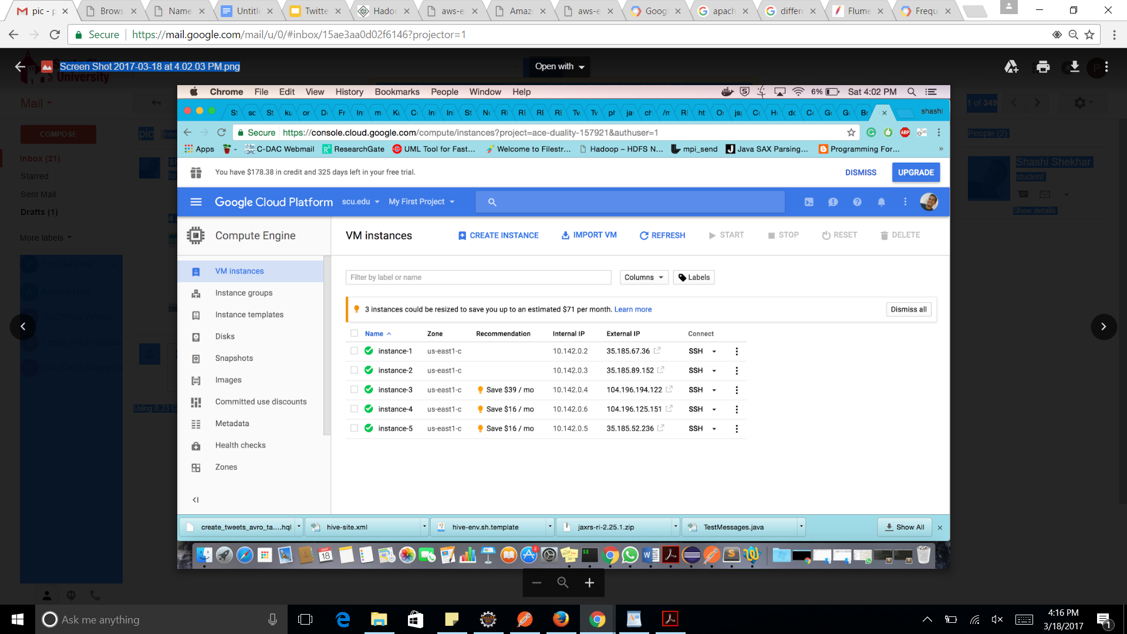
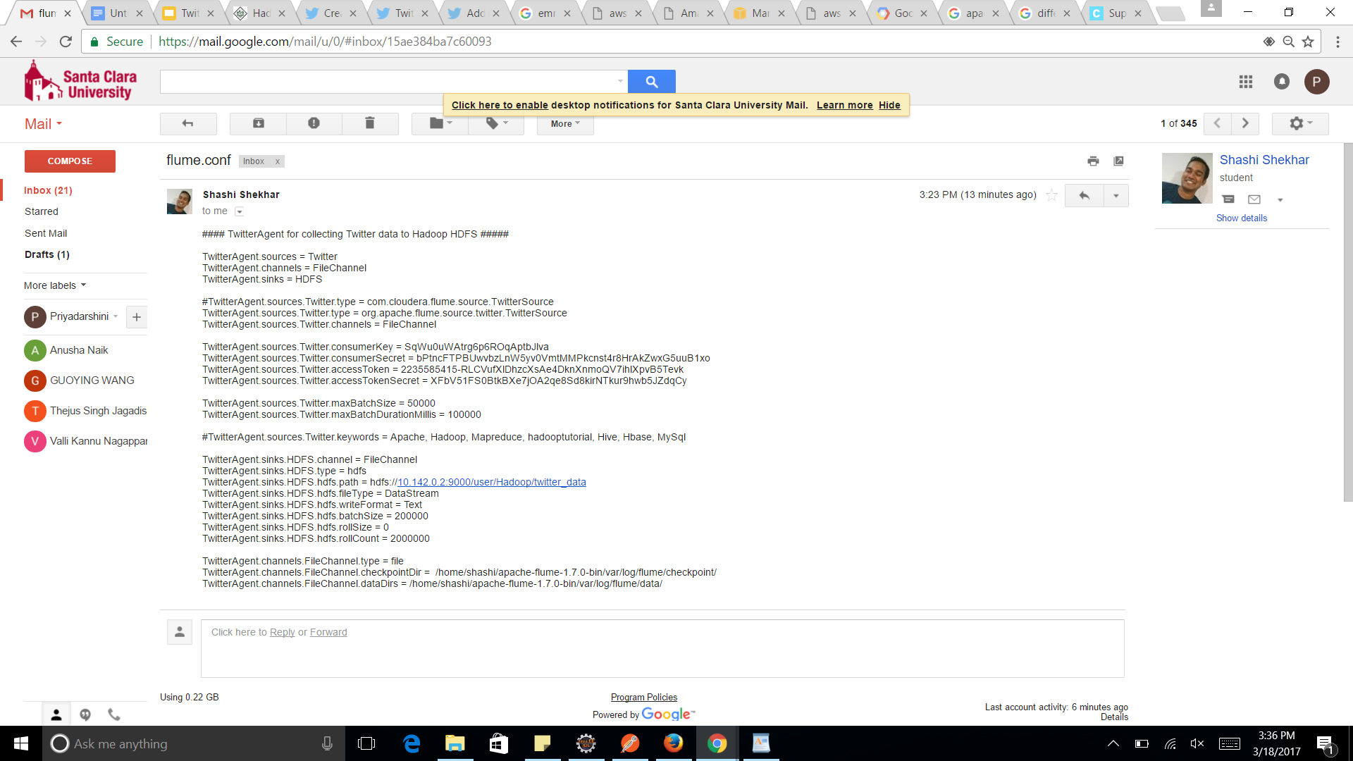
Environment setup
Google Instances
Flume Configuration file

Slide 7
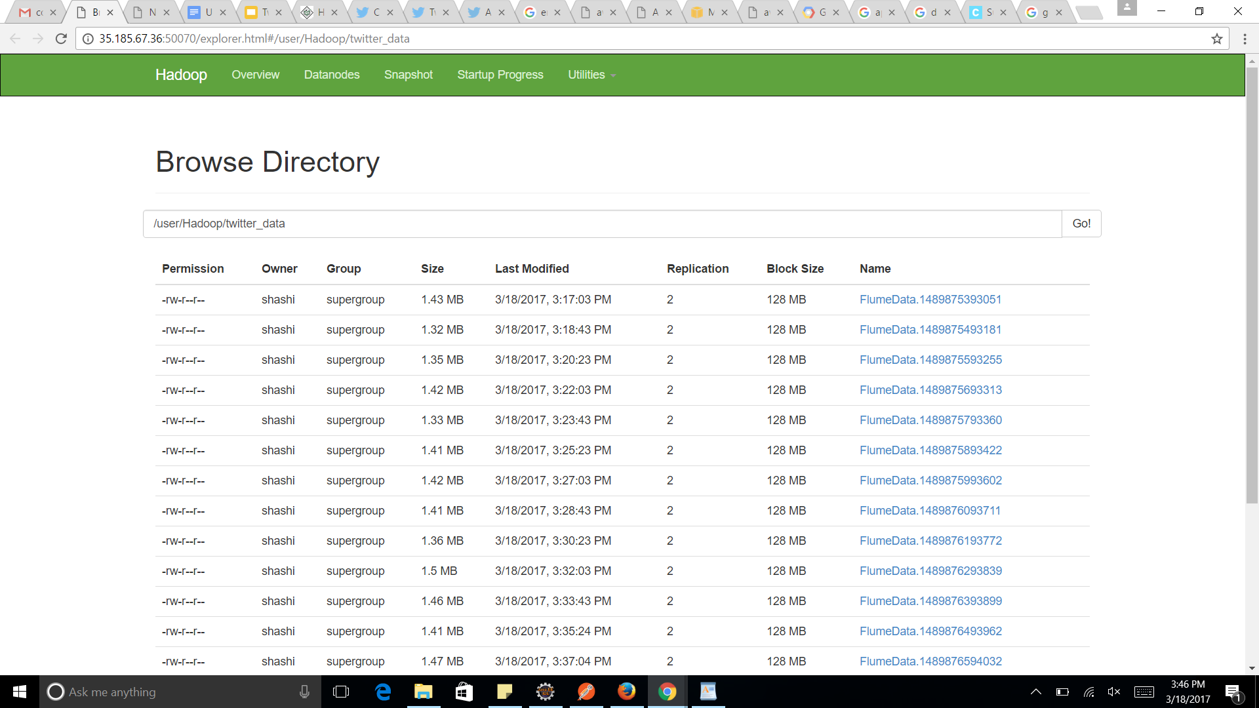
Transferring data into HDFS
bin/flume-ng agent --conf ./conf/ -f conf/twit.conf Dflume.root.logger=DEBUG,console -n TwitterAgent >> log1 2>&1 &

Slide 8
Why WE USED APACHE FLUME
Put command on HDFS can load one file at a time. Data Generators produce continuous data
Collect and aggregate large amount of data and ingest into HDFS
Highly reliable and easily configurable tool principally used to transfer data into HDFS.

Slide 9
Hive
Derby
Web Interface
MetaStore
Command Line Interface
Thrift Server
Driver (Complier, Optimizer, Executor)
HADOOP
Job Tracker
Name Node
Data Node + Task Tracker

Slide 10
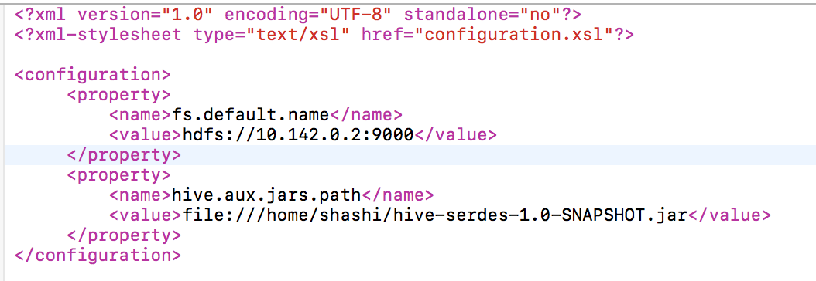
Hive Configurations
Two files are important for configuring hive
(i)hive-env.sh → Script file used for setting up environment variables
(ii) hive-site.xml → set up hadoop name nodes

Slide 11
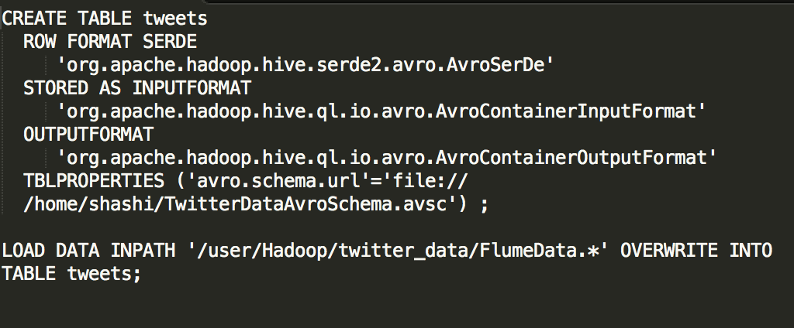
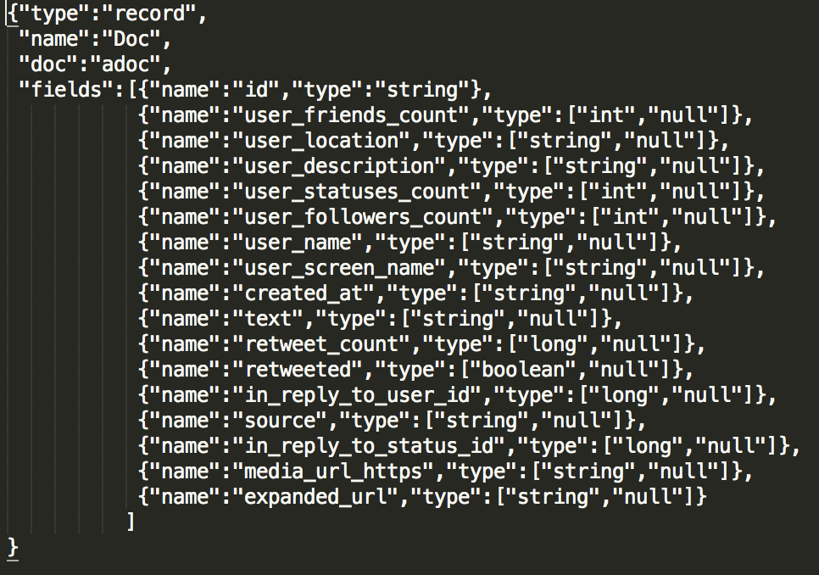
Loading Data from HdFS to Hive

Slide 12
Avro
(i)Data Serialization System
(ii)Apache Avro takes care of null and garbage values
(iii)Compresses Data

Slide 13
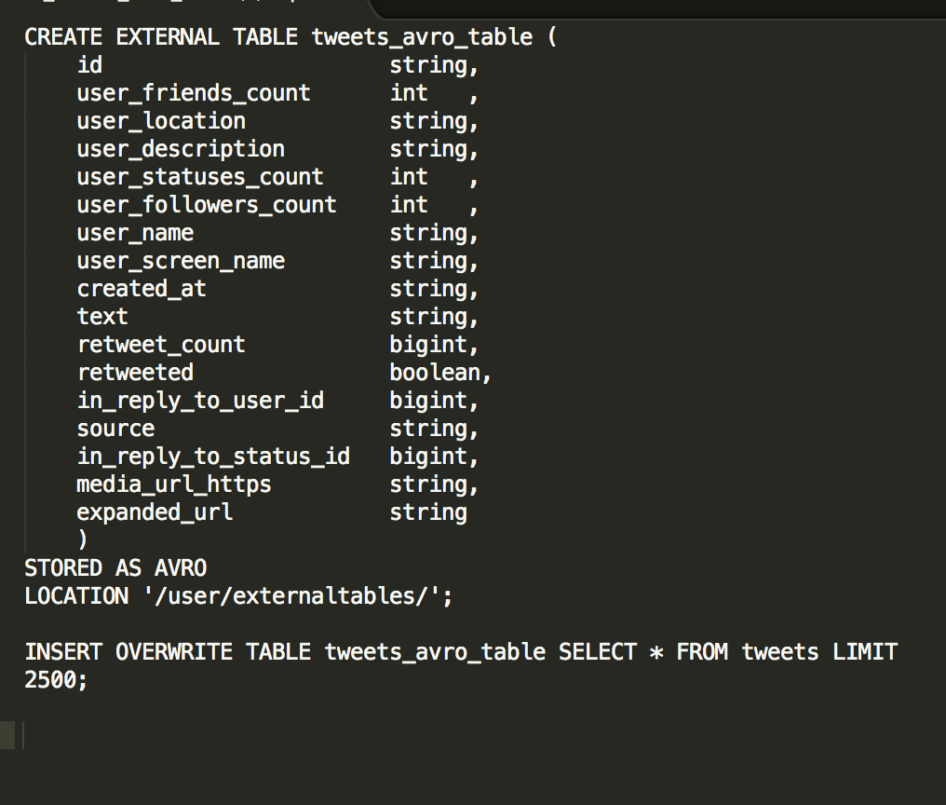
Mapreduce

Slide 14
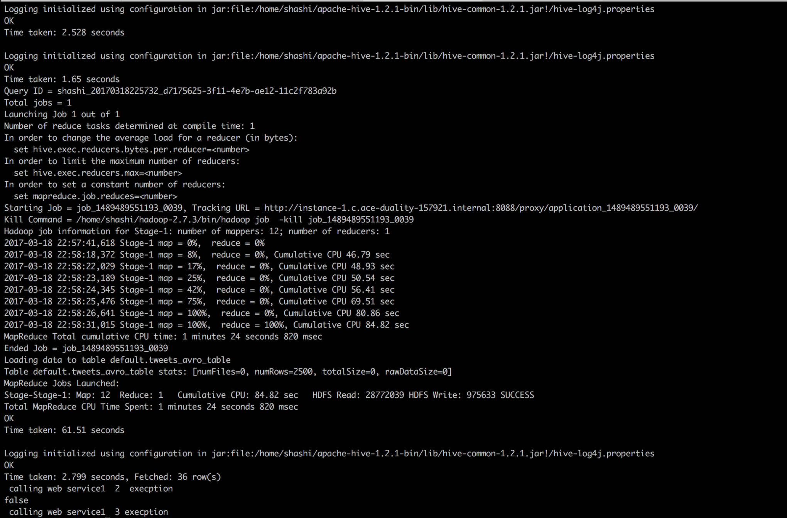

Slide 15
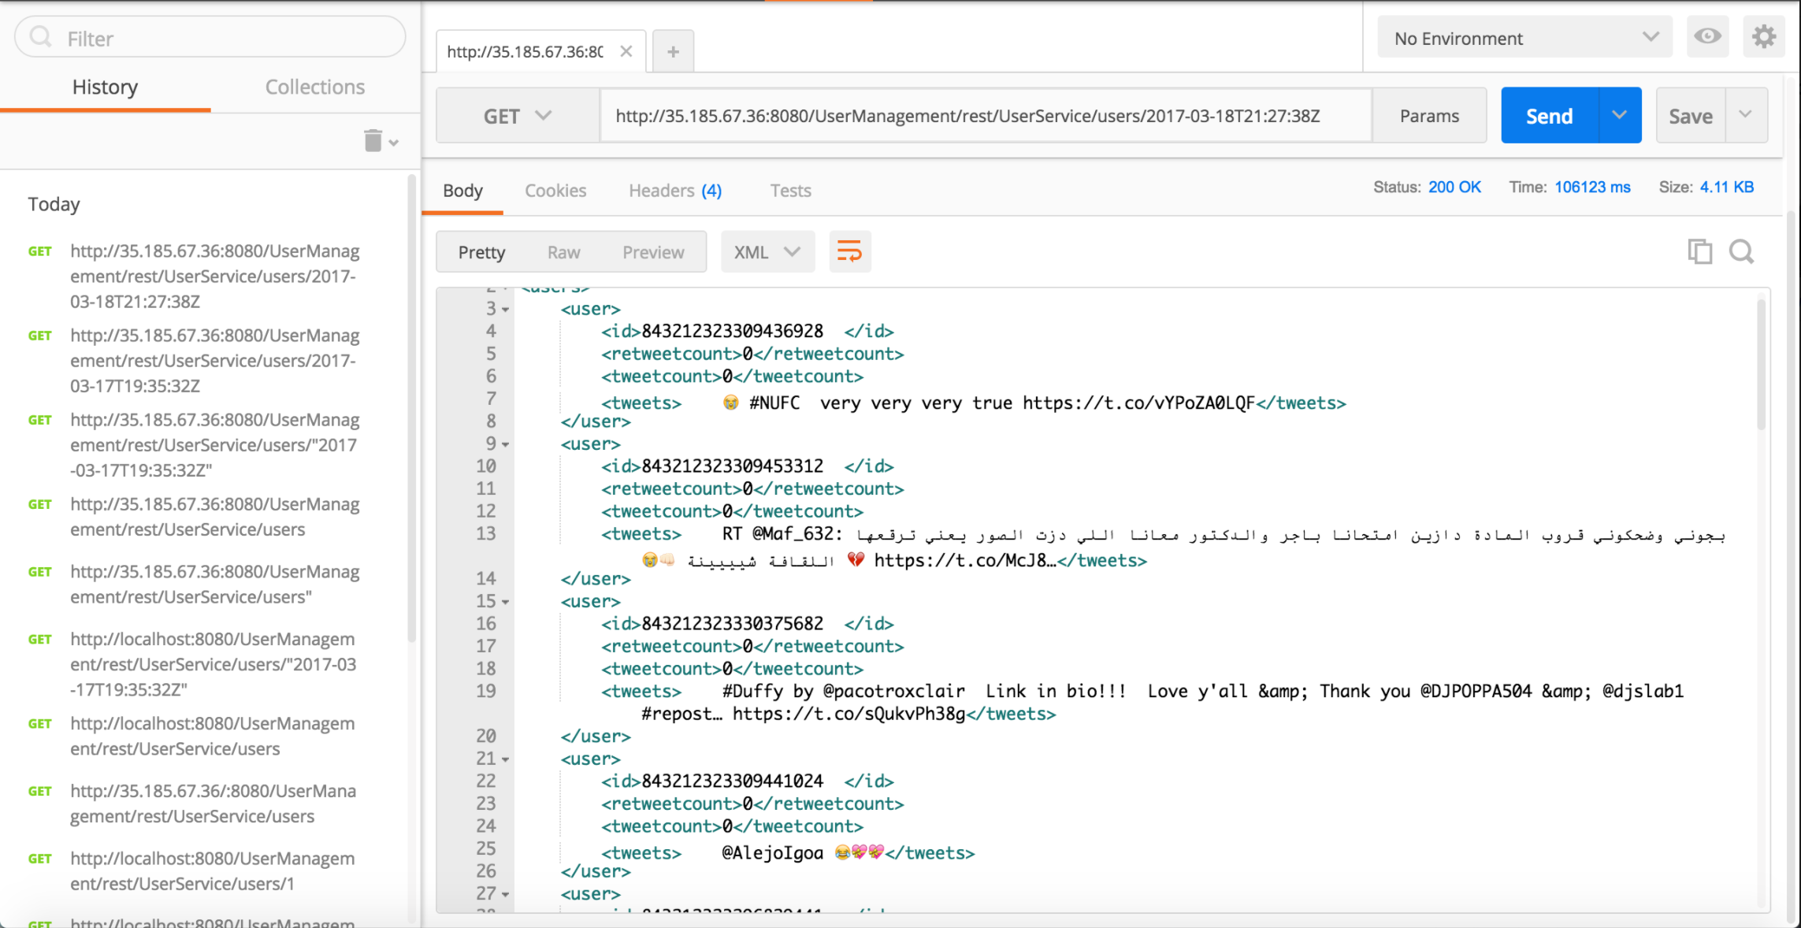
Web Services for queries
Query 1 : All the tweets at a particular time instance
Input : Timestamp
Output : UserId, Tweet text

Slide 16
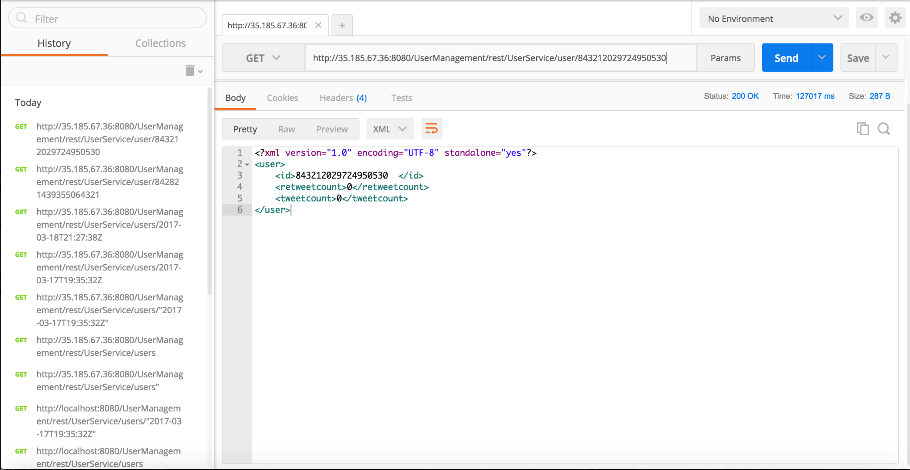
Query 2 : Total number of tweets sent by range of UserIds
Input : UserId
Output : UserId, number of tweets for user

Slide 17
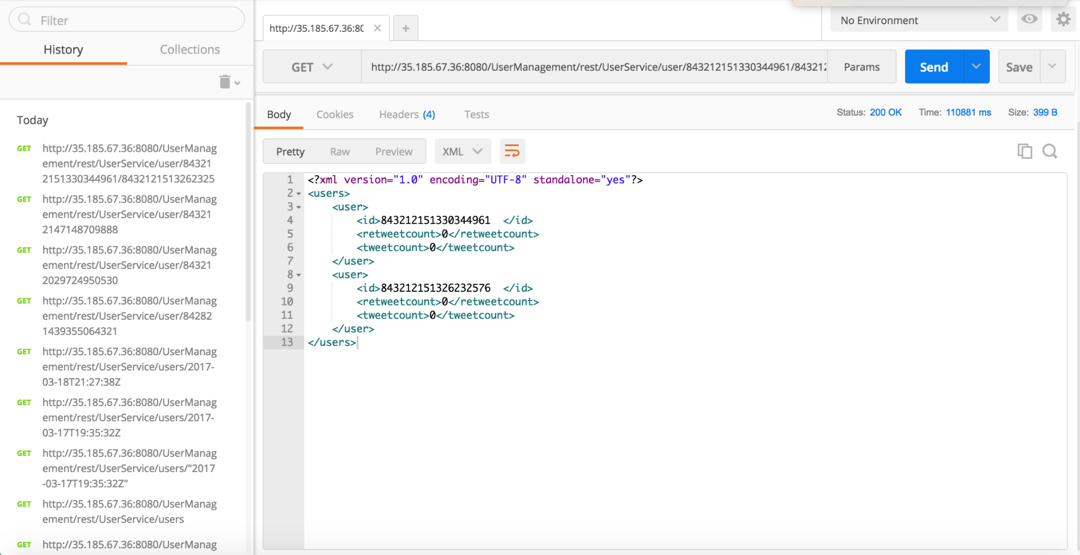
Query 3 : Set of UserIds who have retweeted a tweet posted by given userid
Input : UserId
Output : UserId, Retweet Count

Slide 18
Google Cloud Platform Vs Amazon Web Services
Google cloud has taken the “Pay per use” concept to the extreme. GCE bills in minute level increments.
Load Balancers in GCE don’t need any pre warming.
Major Drawback of Google Compute Engine
Google lacks Widespread Geographical Distribution.
Restricted only to 3 regions(US, Europe & Asia) vs 11 regions.
Ref: http://cloudacademy.com/blog/google-cloud-vs-aws-a-comparison/

Slide 19
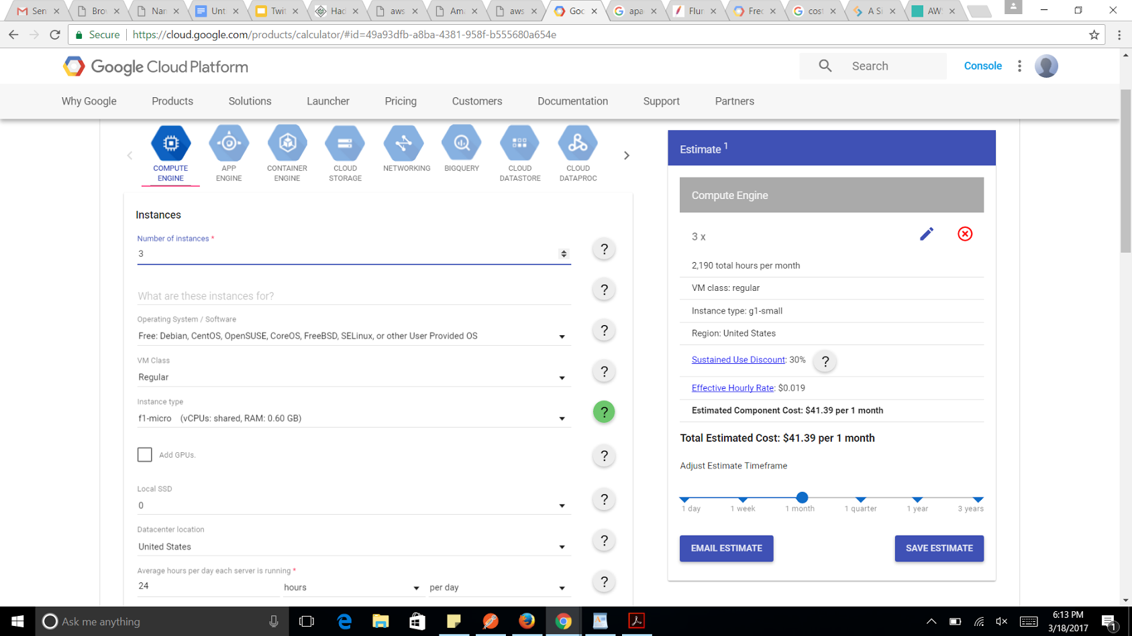
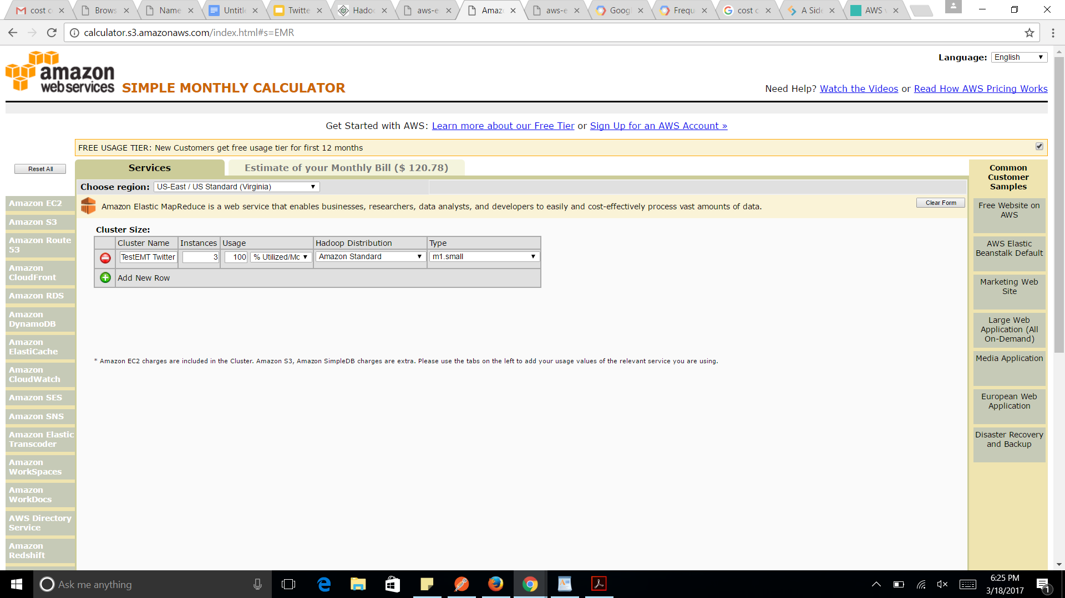
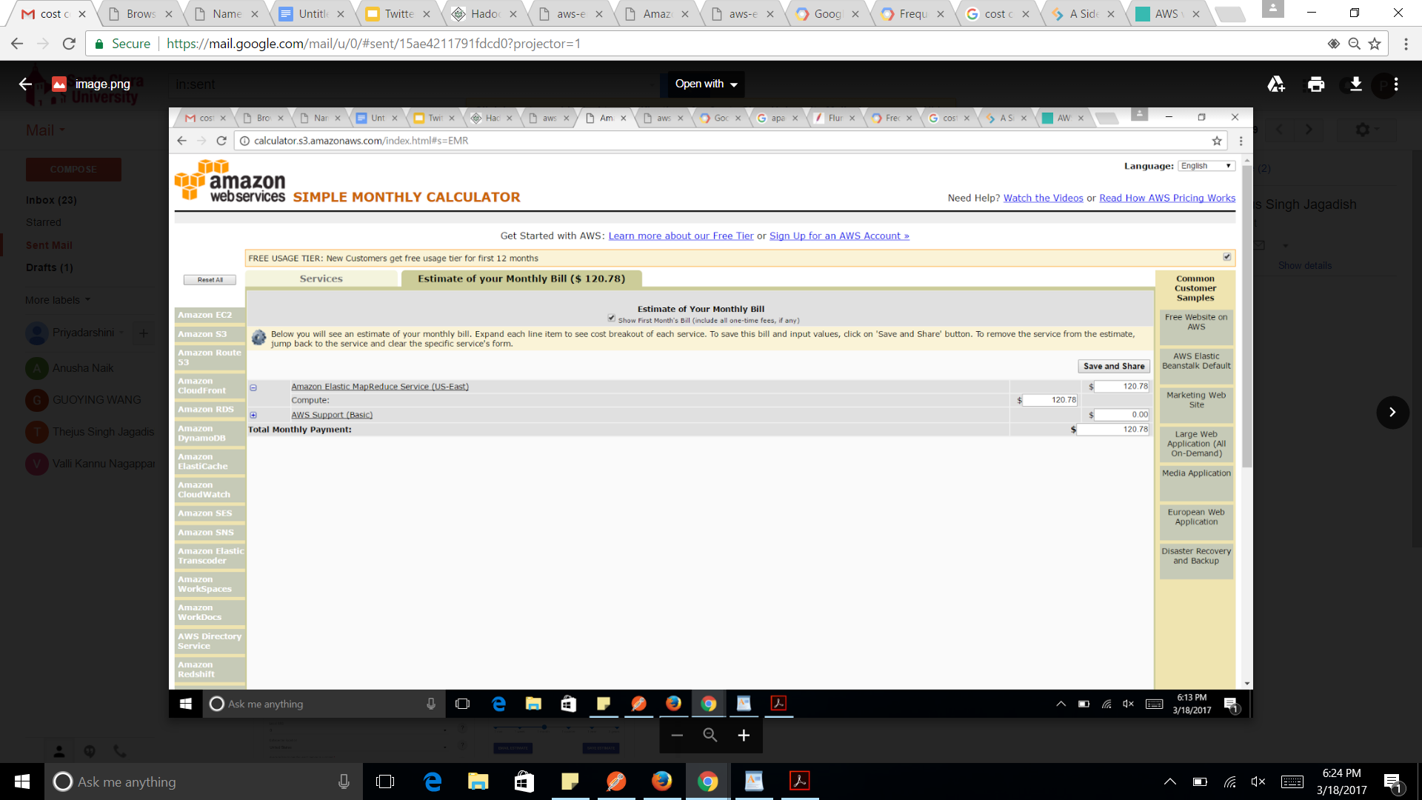
Cost COMPARISONS
Amazon EMR
Google Instance

Slide 20
THANK YOU !

